Slide 1
Final Project Presentation
CS4830: Big Data Laboratory
Vishal Rishi CH18B013
Rajas Takle CH18B114
Vignesh Kumar CH18B118
CS4830: Big Data Laboratory

Slide 2
Problem Statement
Yelp Dataset
Around 11.5 million rows (with null values) and 3.7 million rows (clean data)
9 columns:
Column 0, 4, 8 are id’s
2: Dates, 6: Text review, 5: Target ratings
1, 3, 7 are votes.
We aim to use NLP to predict star ratings on Yelp Dataset

Slide 3
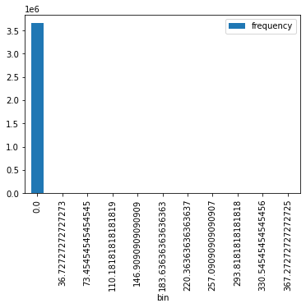
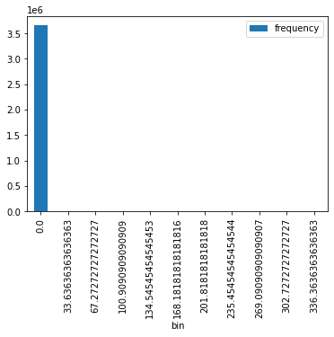

Data Analysis
Usefulness of voting columns:
C1 C3 C7
All values are predominantly zero. Hence, they are not apt for predicting ratings.

Slide 4
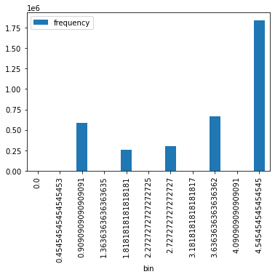
Data Analysis and Textual Data
Target Predictions
TF - IDF:
Term Frequency - Inverse Document Frequency
TF-IDF is the product of TF and IDF
TF: Number of times the word appears in a document
IDF: Measure of how common a word is in a document. Logarithmic scaled inverse fraction of document containing the word
Frequent terms would have lower weights and infrequent terms would be weighed more
TD-IDF is the product of TF and IDF
One
Two
Three
Four
Five
Hence, only textual information is used in our model to predict target rating predictions.
Target ratings are mostly 5 star and rest of the ratings are almost equally split

Slide 5
Model Pipeline
Data Preprocessing
Tokenization, Stopwords Removal
N-grams:
Here we have used n=2. This pairs words continuously occurring into one and forms another vector.
Count Vectoriser:
Create a dictionary out of the words, and store the counts.
Tf-idf:
Preprocessing which takes in the input of bigrams and weighs based on occurrences of the importance of each word.
Vector assembler:
Assembles into feature vector of TF-IDF scores for each bigram
Logistic Regression:
Regularization Parameter = 0.1, 20 iterations

Slide 6
Model Training and Evaluation
Training was done in a dataproc cluster
Clean data (of around 3.7 million rows) were used for model training
80 - 20 % Split for Train and Test data
Model is saved in GCP bucket after training for further usage
Evaluation:
Model trained resulted in accuracy of 0.672607 and a F1 score of 0.6229 in test dataset

Slide 7
Real Time Computation
Using Kafka to perform real time inference on streaming data
Producer:
Read CSV file from cloud storage
Preprocess data
Iterate through a collected version of subset of data
Use Kafka producer to dispatch the data to a kafka topic
Subscriber:
Read rows from Kafka Topic using Readstream API
Process the data and pass it into the model
Calculate accuracy and F1 score and write the information to console using the writestream API

Slide 8
Thank You

